Slide 1
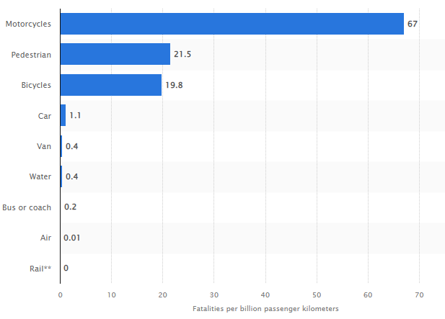
Passenger vehicles are by far the most dangerous of the transportation options compared. Passenger vehicle death rate per 100,000,000 passenger miles was over 10 times higher than for buses, 17 times higher than for passenger trains, and 1.623 times higher than for scheduled airlines.
The majority of aviation fatalities that occur each year (85%) involved private aircraft (known as “general aviation”)
Commercial aviation is the safest mode of travel in the United States, with 0.07 fatalities per billion passenger miles.
More than 1.24 million people die every year as a result of road traffic injuries, making it the eighth leading cause of death globally.
Crash death costs over 430 billion $USD annually.
Motorcycles are the transportation mode with the majorities of fatalities regarding traffic incidents in Great Britain
References:
https://journalistsresource.org/economics/comparing-fatality-risks-united-states-transportation-across-modes-time/
https://injuryfacts.nsc.org/home-and-community/safety-topics/deaths-by-transportation-mode/
https://www.bts.gov/content/transportation-fatalities-mode
https://www.cdc.gov/transportationsafety/pdf/CDC-DIP_At-a-Glance_Transportation_508.pdf

